Slide 1
ECE 322L
Electronics 2
03/31/20 - Lecture 18
Capacitive effects in BJTs

Slide 2
Updates and overview
Please, refer to the announcements on UNM Learn for the revised due dates.
Midterm 2 will be next week. See the announcement on UNM Learn for additional details.
Today:
High frequency response of BJT-based amplifiers
Capacitance effects in a p-n junction
Parasitic capacitance in a BJT
(Neamen 7.4.1)
Augmented π-model (Neamen 7.4.1)
Miller effect (Neamen 7.4.4-7.4.5)
4/4/2019

Slide 3
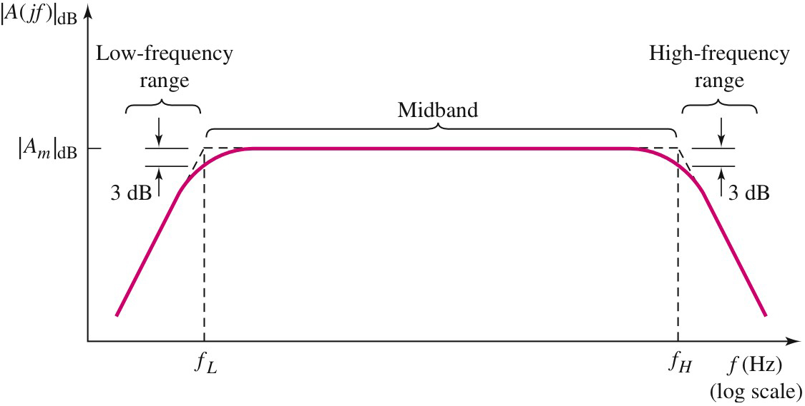
Amplifiers frequency response at high frequency
At high frequency the gain decreases due to
Internal capacitances of the transistors
Parasitic effects
Load capacitors
4/4/2019
Notes:
This slides reminds you of the shape of the frequency response of the amplifier. In the previous lecture we modelled the effect of circuit capacitors at low and high frequency. In this and in the next lecture we’ll focus on the internal capacitors of BJTs and FETs and how they affect the frequency response of an amplifier.

Slide 4
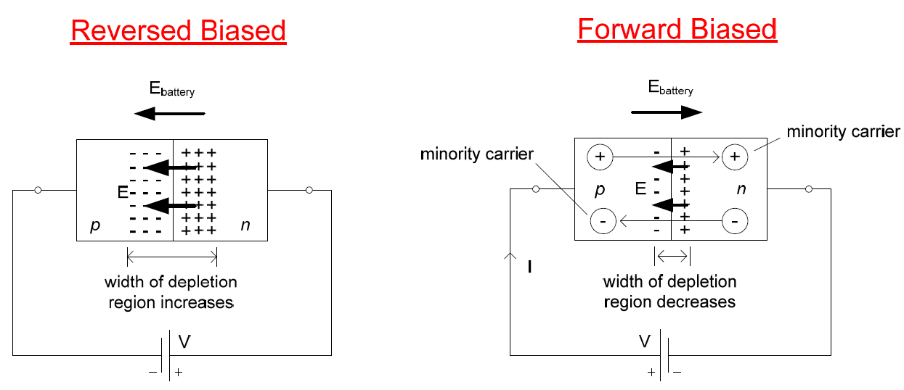
Capacitances of a pn junction
Reverse biased junction:
Junction capacitance
Forward biased junction:
Junction capacitance and diffusion capacitance
4/4/2019
Notes:
As BJTs include 2 p-n junctions, it is important to review capacitive effects in a p-n junction in order to understand the origin of the BJT internal capacitors.

Slide 5
Junction capacitance of pn junction
The width of the depletion region (and the amount of fixed charge stored in it) will change depending on the applied voltage in both FB and RB junctions.
These fixed charges create an electric field across the pn junction that will vary with time when a signal source is connected to the device.
This overall effect can be modeled by what is called the junction capacitance
4/4/2019
Notes:
This slides explains the origin of a junction capacitance in a p-n junction.

Slide 6
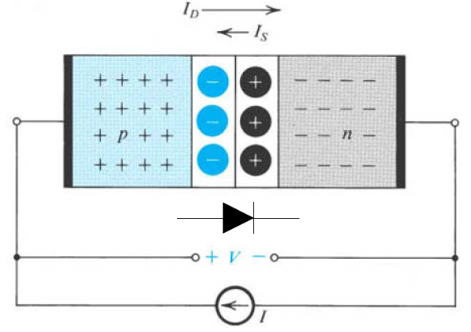
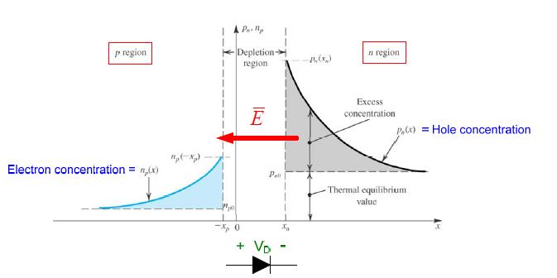
Diffusion capacitance of a pn junction
In FB junctions holes are injected across the junction into the n region while electrons are injected across the junction into the p region.
The concentration of these electrons and holes decreases away from the junction due to recombination effects.
These concentration of charges create an electric field across the pn junction that will vary with time when a signal source is connected to the device.
This overall effect can be modeled by what is called the charge storage capacitance or diffusion capacitance.
4/4/2019
Notes:
This slides explains the origin of a diffusion capacitance in a p-n junction.

Slide 7
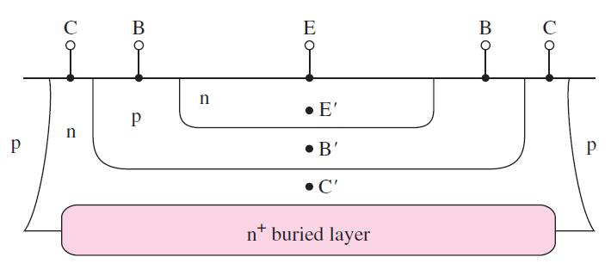
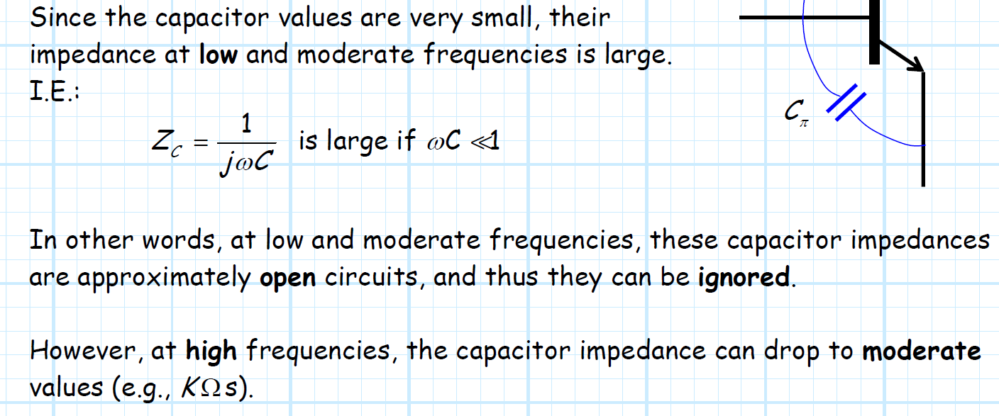
Capacitances of in a BJT
C_{π}
C_{μ}
C_{s}
4/4/2019
Notes:
This schematic illustration identifies the three internal capacitors of a BJT.

Slide 8
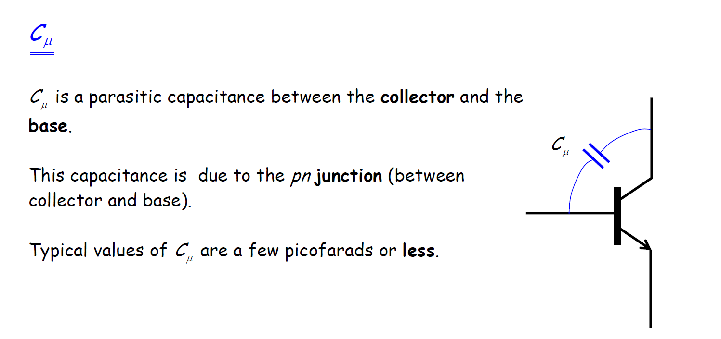
Capacitance associated with the B-C junction
Junction capacitance
Valid in Forward-active region
4/4/2019
Notes:
This slide specify the nature of C_μυ ιν τηε φορωαρδ αχτιϖε ρεγιον.

Slide 9
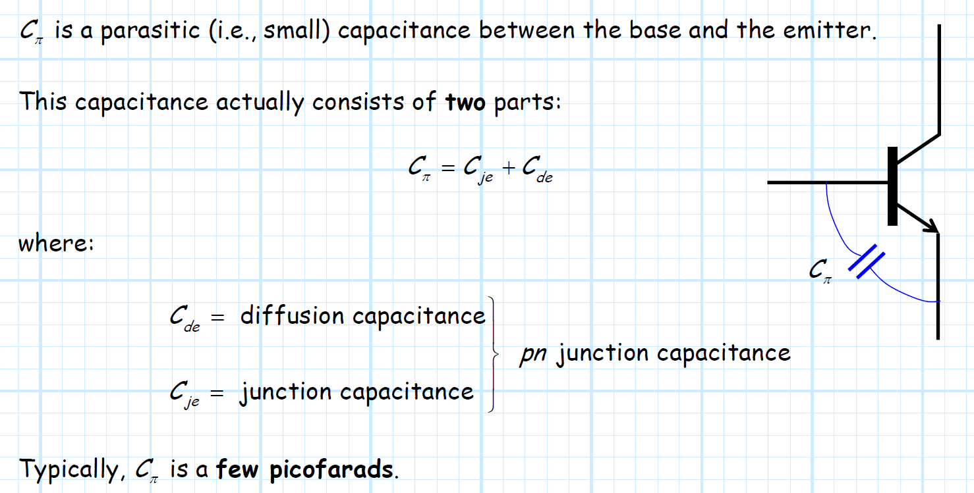
Capacitance associated with the E-B junction
Valid in Forward-active region
4/4/2019
Notes:
This slide specify the nature of C_πι ανδ ιτσ ορδερ οφ μαγνιτυδε

Slide 10
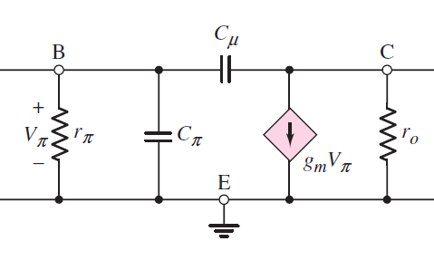
Augmented π-equivalent circuit
C_{π}
C_{μ}
4/4/2019
Notes:
It is usually reasonable to neglect Cs as it is very small. This slides shows the augmented small signal model for BJT at high frequency

Slide 11
Miller’s Theorem
This theorem simplifies the analysis of amplifier at high frequency.
The theorem states that if an impedance is connected between the input side and the output side of a voltage amplifier, this impedance can be replaced by two equivalent impedances, i.e. one connected across the input and the other connected across the output terminals.
4/4/2019
Notes:
The Miller’s theorem is relevant to determining the upper corned frequency and thus the bandwidth of an amplifier.

Slide 12
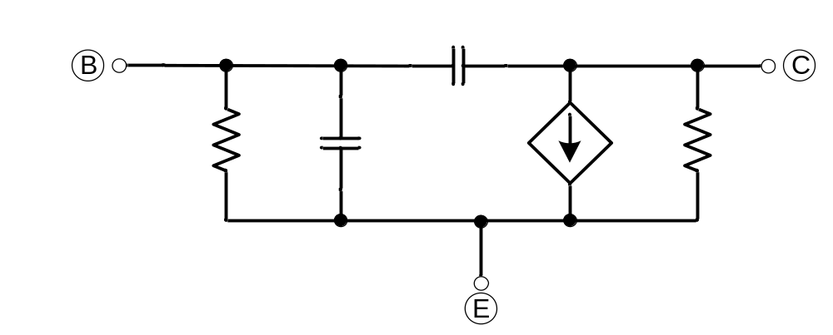
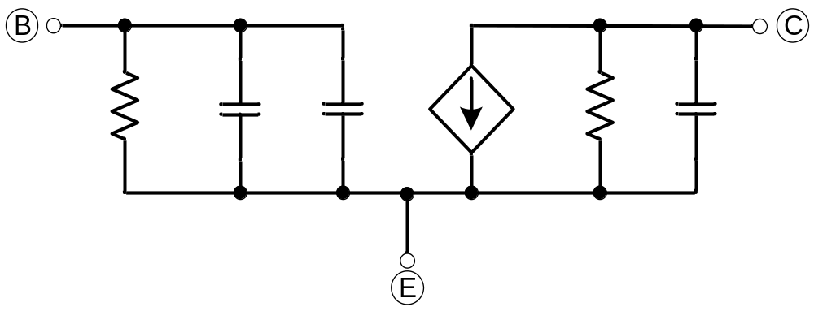
Miller’s Theorem applied to a BJT
C_{μ}
+
r_{π}
V_{π}
C_{π}
g_{m}V_{π}
r_{o}
-
r_{π}
C_{π}
C_{Mi}
r_{o}
g_{m}V_{π}
C_{Mo}
4/4/2019

Slide 13
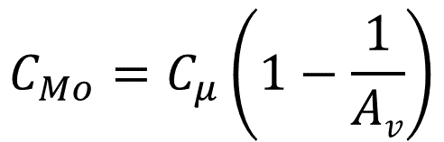

High-frequency hybrid-π model with Miller effect
r_{π}
C_{π}
C_{Mi}
r_{o}
g_{m}V_{π}
C_{Mo}
Miller
approximation
G is the midband gain
4/4/2019

Slide 14
Open-circuit time-constant method (OCTC)
Used to determine the high cut-off frequency for a circuit including n capacitors.
Step-by-step method
Draw the ac equivalent circuit including only the capacitors yielding a low pass response (All the other capacitors will act as short circuits).
Calculate the corner frequencies determined by each capacitor as ω_{Hi}=1/2πC_{i}R_{iH} by replacing all the other capacitors with open circuits.

Slide 15
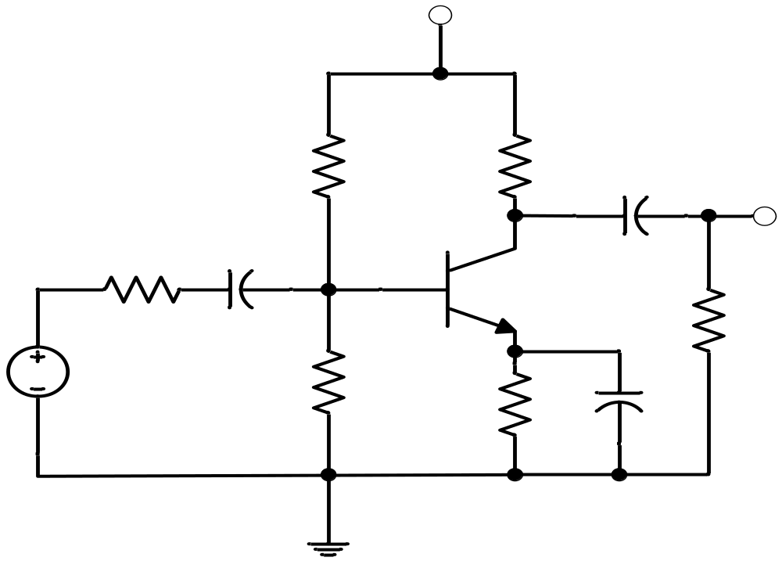
Lecture 18-In class problem
V_{CC} = 10V
Given :
= 125, C_{be} = 20 pF, C_{bc} = 2.4 pF, V_{A} = 70V, V_{BE}(on) = 0.7V
g_{m}=73.35 mA/V
r_{o}=36.8 kΩ
r_{π}=1.7 kΩ
R₁
R_{C}
C₂
22 kΩ
v_{O}
2.2 kΩ
R_{S}
C₁
10 μF
600 Ω
10 μF
R_{L}
2.2 kΩ
v_{S}
R₂
R_{E}
C₃
4.7 kΩ
10 μF
470 Ω
Determine the upper cut-off frequencies for the circuits above
4/4/2019

